Slide 1


RF-bypasses in the PSB
Question 1:
Can we keep the present rf-bypasses in the PSB during the L4 era?
Answer to 1: YES
Question 2:
Why would it help to keep them?
Answer to 2: there are 132 (32 per ring) isolated flanges - with rf bypasses - in the PSB, to be changed, which means 2 months work for the rf team and same (?) for the Vacuum team

Slide 2
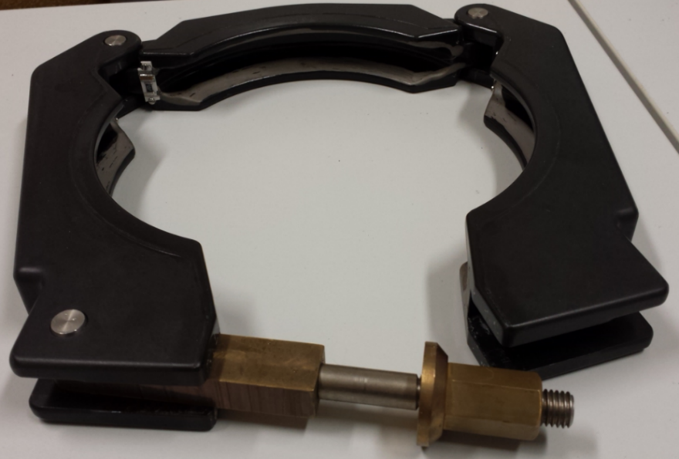
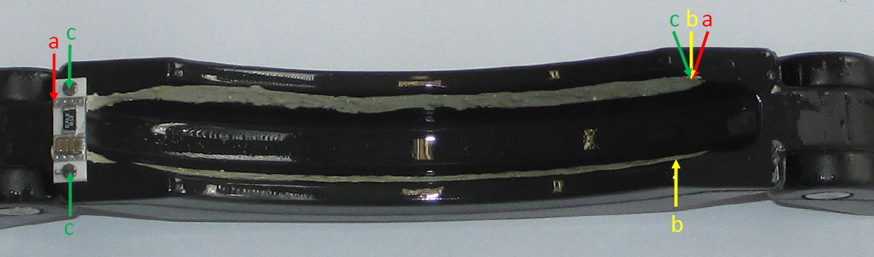
RF-bypasses in the PSB
What is the present setup?
3 times
0.5Ω in series with
4 x 100nF //
=> 384 circuits

Slide 3
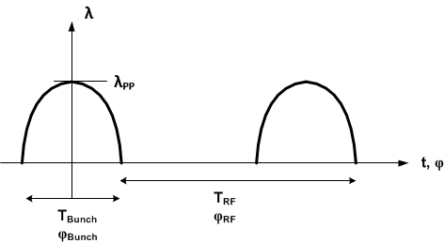

RF-bypasses in the PSB
What future beam current is involved ?
(beam to be shared in between 3 bypass circuits)
The Max peak beam intensity will be considered with
1.6E13 ppb and 130 ns bunch length
$${I_{beam peak Linac 4 at ej}=λ}_{pp ej}=\frac{π}{2}∙\frac{Q_{Bunch}}{T_{Bunch}}=\frac{3.14∙1.6∙{10}^{13}∙1.6∙{10}^{−19}}{260∙{10}^{−9}}=31A_{p}$$

Slide 4
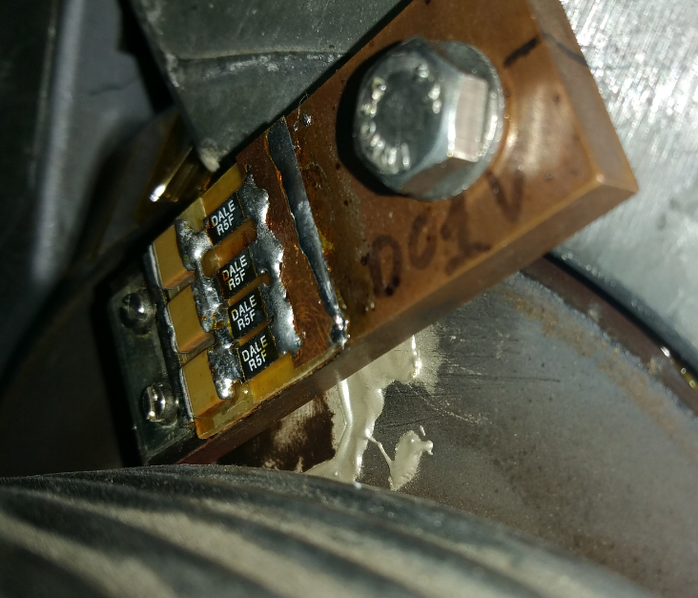
RF-bypasses in the PSB
Test in the PS
The PS delivers 100 A_{peak} and we need to test the resistors for 10.3 A_{peak} (centred beam) to 31 A_{peak} (very off-center full intensity beam)
4 resistors in // means 25 A_{peak}
The test was OK (2 months test in April and May 2017)
The next step is to remove one resistor for a test at 33 A_{peak} … although this current is very hypothetic

Slide 5
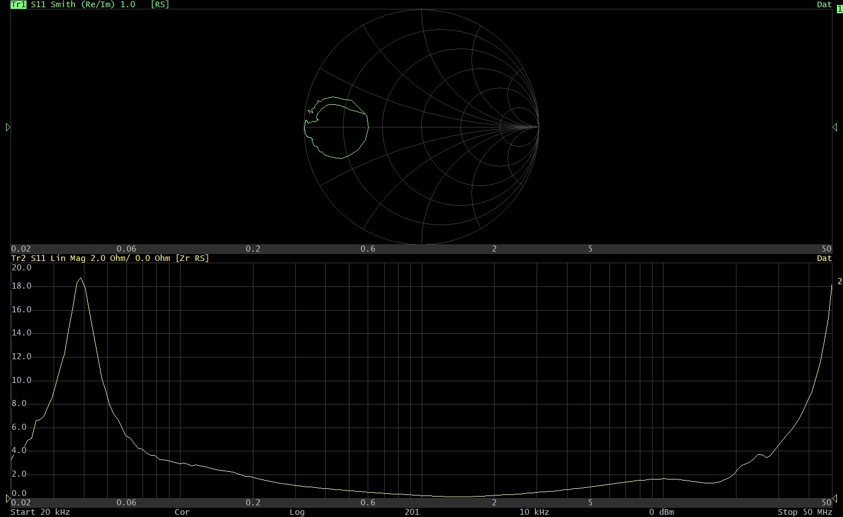
RF-bypasses in the PSB

Slide 6
RF-bypasses in the PSB
CONCLUSION
The resistors into the present PSB RF-bypasses can stand at least 25 A_{peak}.
With L4 the resistors should stand from 10.3 A_{peak} (centered beam) to 31 A_{peak} (totally off-center –thus hypothetic - beam)
This test is conclusive enough to allow for keeping the present PSB setup in the L4 era – (the average dissipated power has also been taken into account)
The resistor will nevertheless be tested for 33 A_{peak} (by removing one of the 4 resistors in the test-bypass in the PS) after the next technical stop + 2 months

