Slide 1
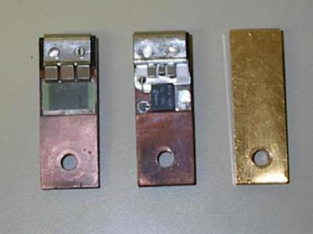
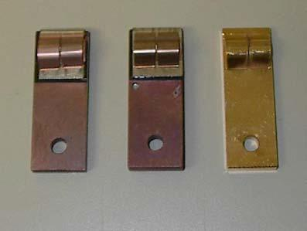
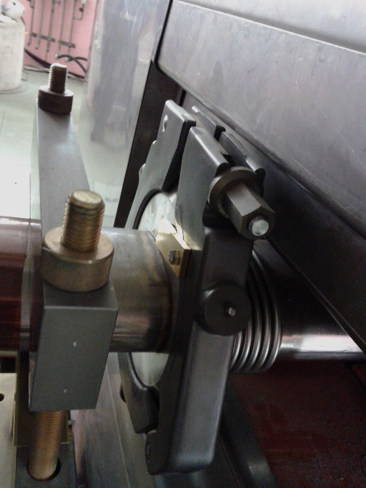
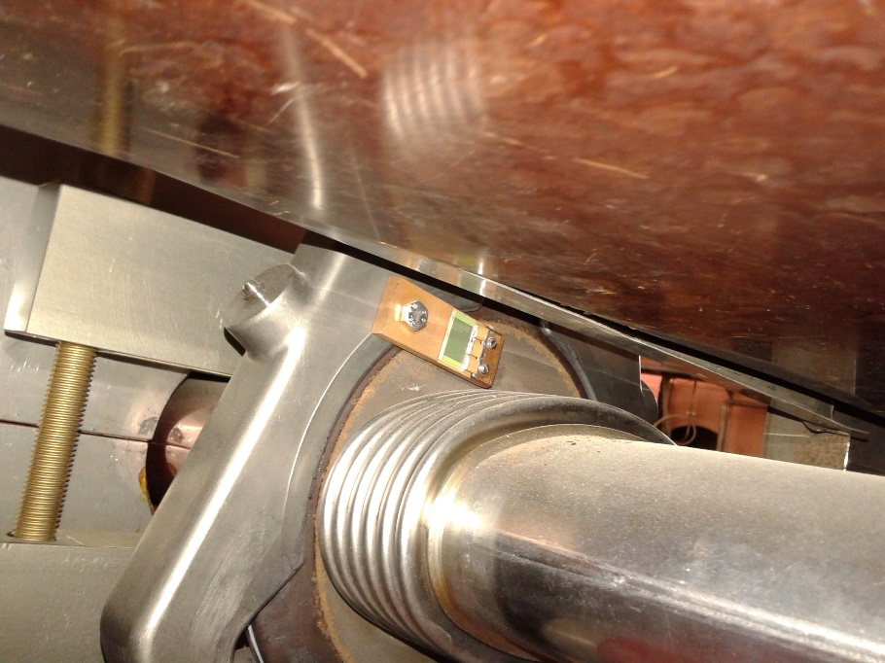
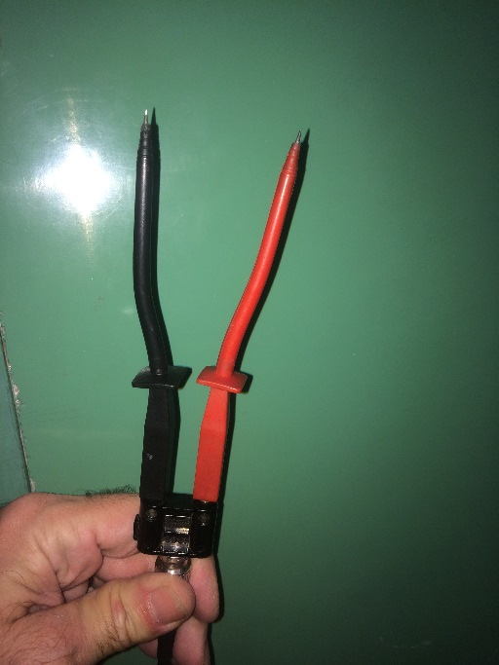

Slide 2
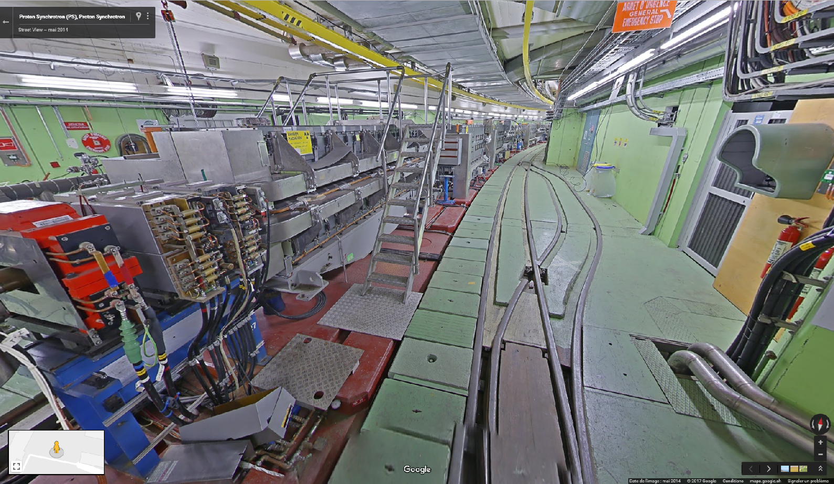

On PS Ring
About 200 flanges to be measured,
Use of a trolley (with big pneumatic wheels because of the rails on the PS) to carry VNA, extension cord, etc…
https://goo.gl/maps/FLDS6ZpcMC22

Slide 3
On PS Ring
About 200 flanges to be measured,
Use of a trolley with big pneumatic wheels because of the rails on the PS
1st part of the job: Interventions where Vacuum chambers are disconnected, we previously removed all the RF Bypasses according to a given list then once the Vacuum group has finished each one of them, we measure the impedance of the flange as the collars risk to damage the enamel insulation of the flanges and cause short-circuits. If ok, we put back the RF Bypass and make a measurement to be sure. 200uS radiation taken.
2nd part of the job: Start measurement campaign from SS01 to SS100, 2 flanges per Straight Section, a few SS have 3 flanges. 230V AC plugs every 10 meters, since decades we use a 20 meters AC power cord extension in order to make several measurements and limit the number of powering down the VNA to less than 20.
Since 2014 we inserted an uninterruptible power supply UPS so it keeps the VNA powered while we move the extension cord.
50uS radiation taken on this 2nd part.

Slide 4
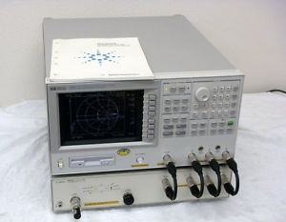
History
… 2013, then 2015 and 2016
Agilent 4395A
SS02 Upstream
Fast Boot 15s
30s state load from FDD
Image saved to FDD, about 1 minute

Slide 5
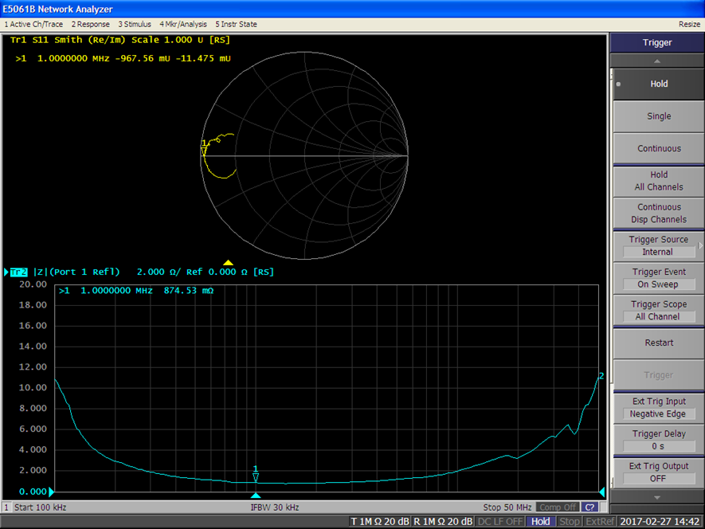
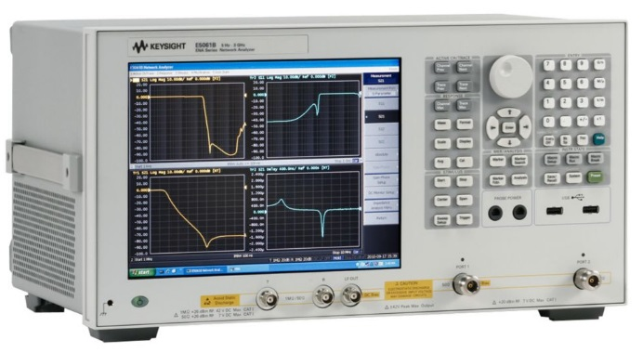
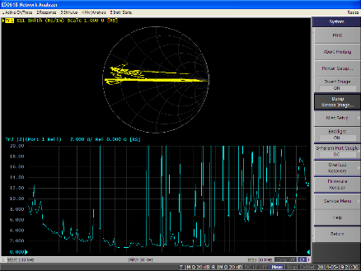
History
2014 and 2017 Agilent E5061B
☹ Very slow Boot 3 minutes (MS Windows),
☺ Image saved to USB, about 10 seconds,
☺ Inserted UPS, huge gain of time
☹ Problems in 2015, we forgot to press hold before saving plots, this VNA continues to scan while its saving, bad contacts caused bad pictures.
SS52 Downstream

Slide 6
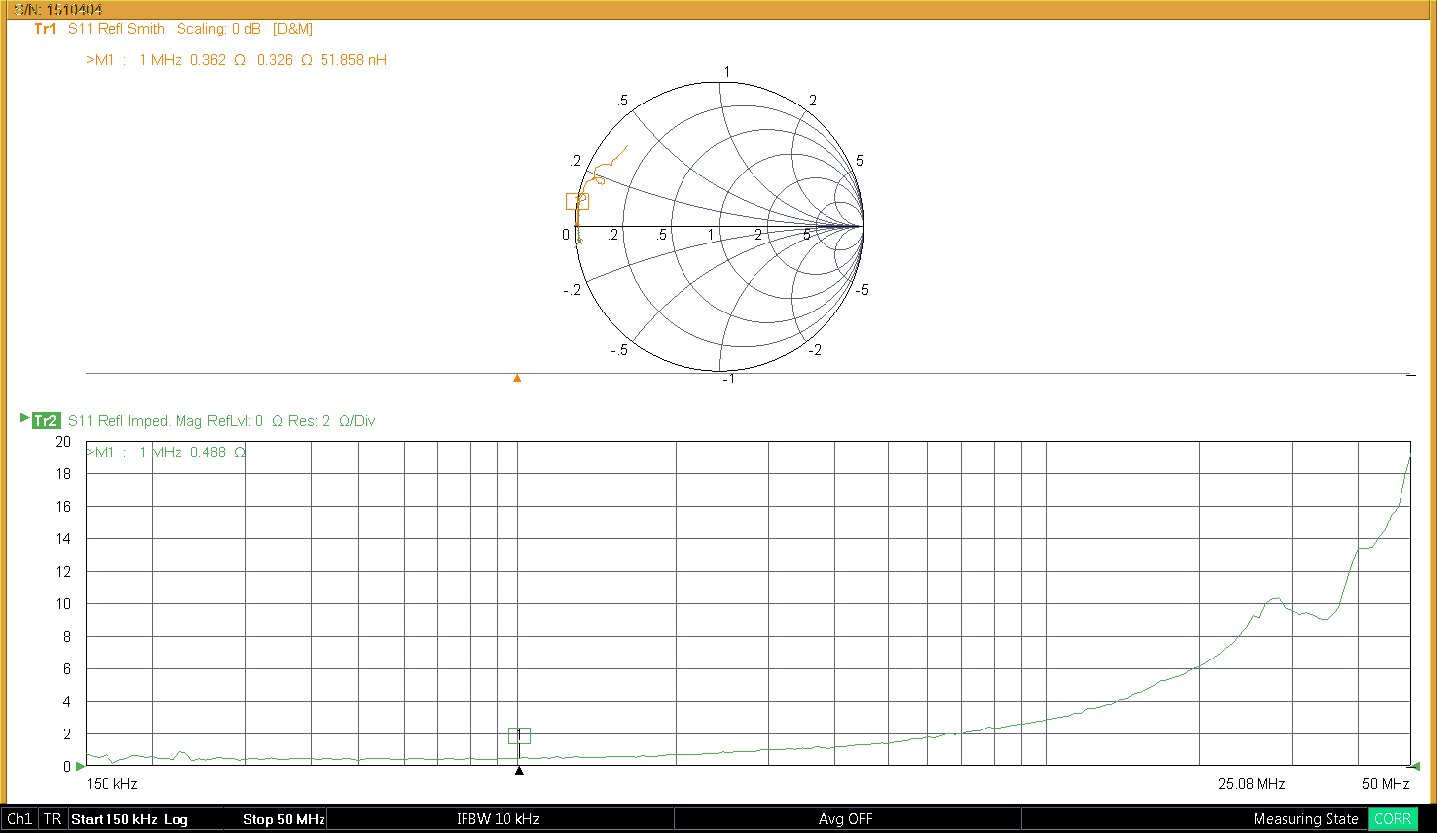
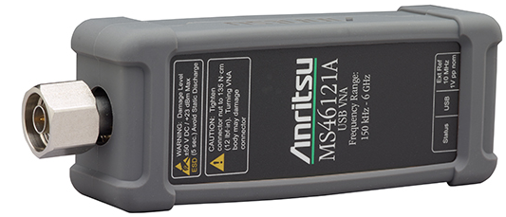
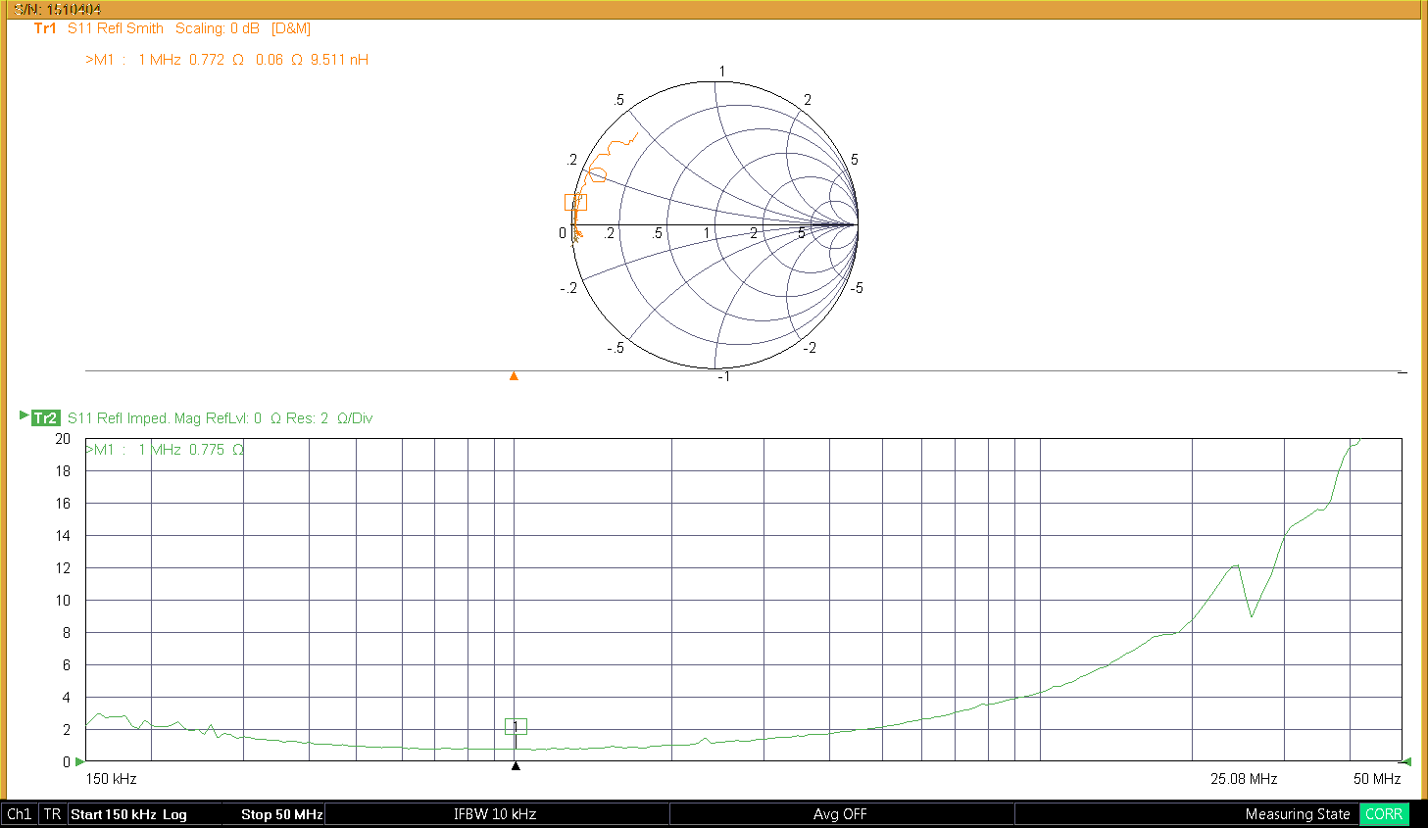
VNA Evaluations
☺ Powered by USB Only,
☺ Friendly user interface software,
☺ Very Fast Scanning,
☺ Easy to save plots,
☹ Min Frequency starts at 150kHz ☹

Slide 7
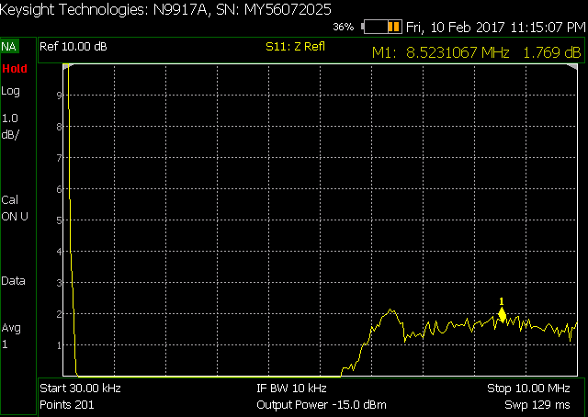
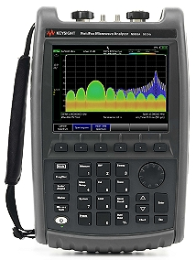
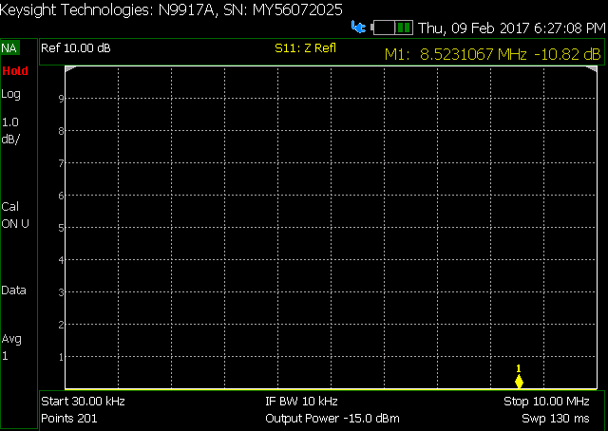
VNA Evaluations
SS46V
☺ No need of PC Laptop,
☺ Friendly user interface software,
☺ Very Fast Scanning,
☺ Easy to save plots, (need keyboard)
☺ Start Frequency at 30kHz,
☹ Only Linear Frequency Scale ☹
Short Circuit

Slide 8
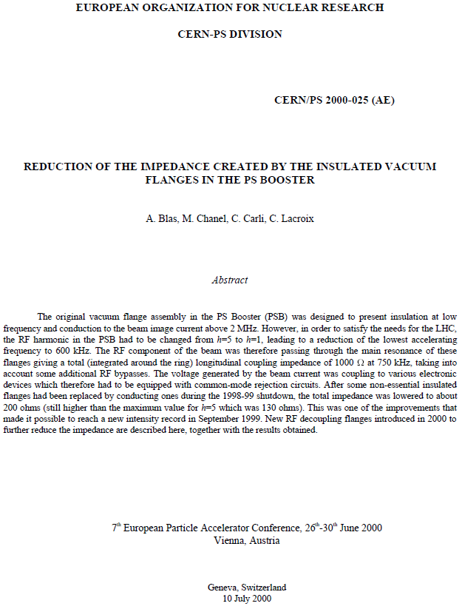
THE PSB
Fabrice Chapuis
https://edms.cern.ch/ui/file/1558565/3/Renovation_Collier_Impedant_Booster.pdf

Slide 9
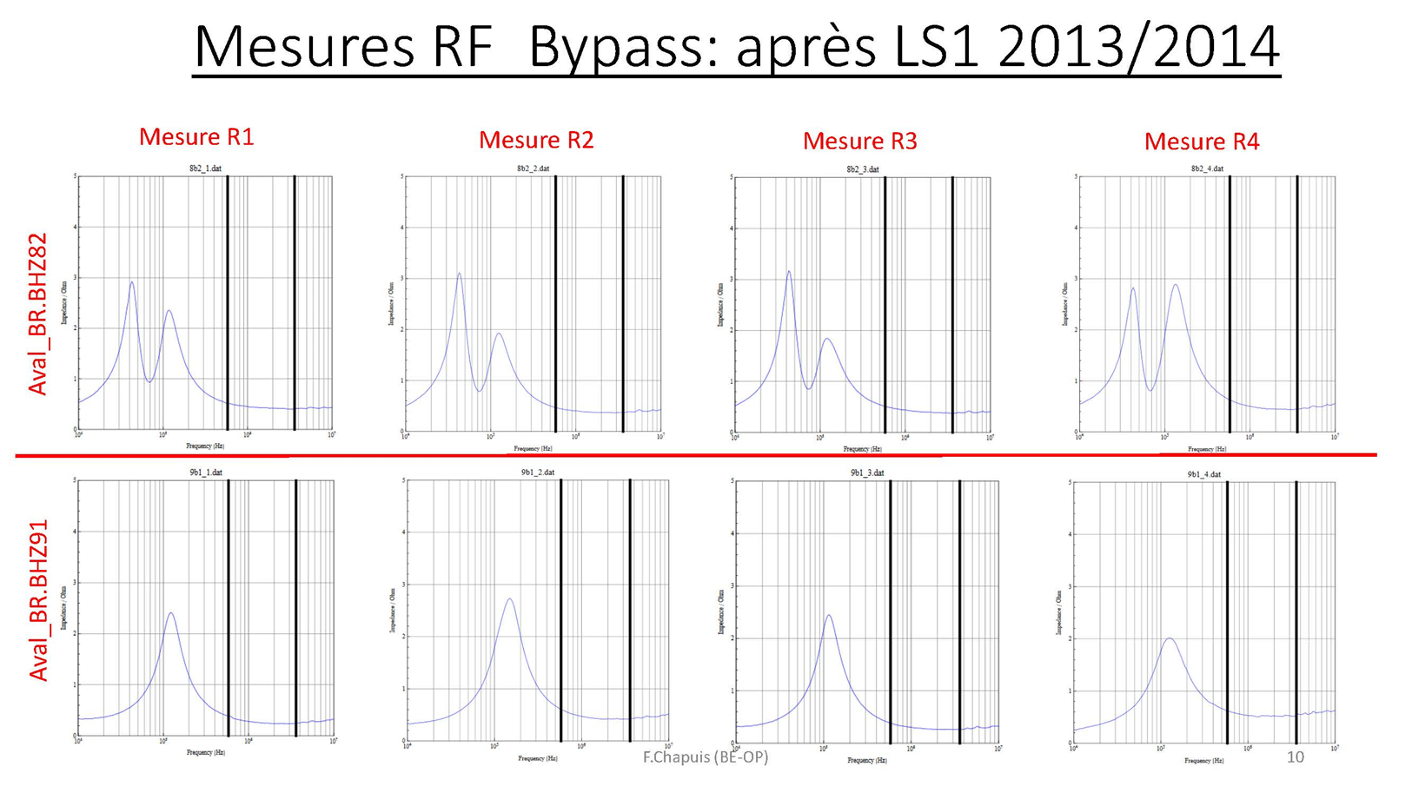
2016.09.15.Bypass_RF_section_9_du_PSB.pdf

Slide 10
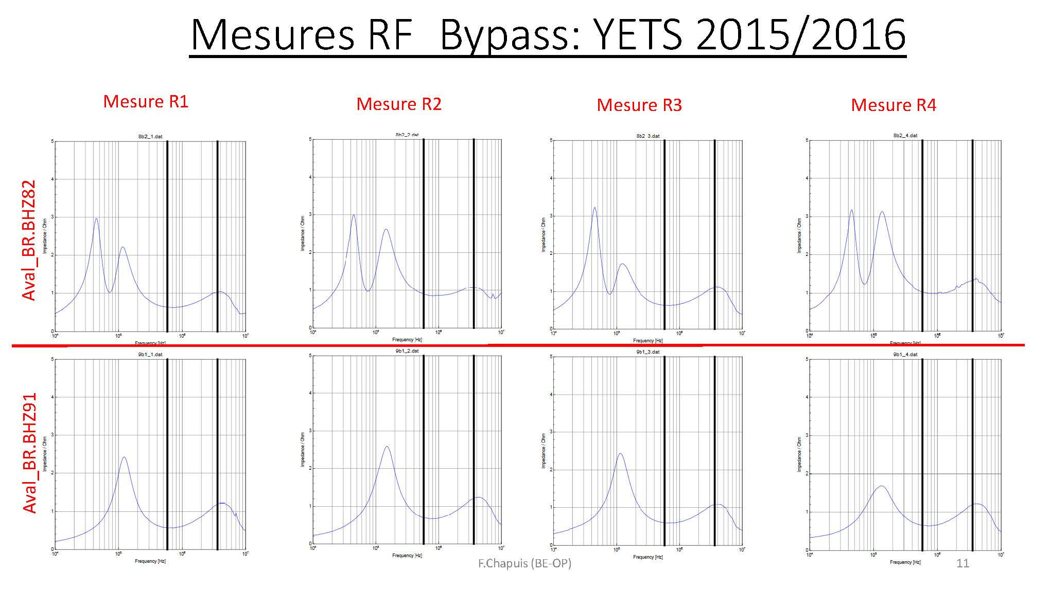
2016.09.15.Bypass_RF_section_9_du_PSB.pdf

Slide 11
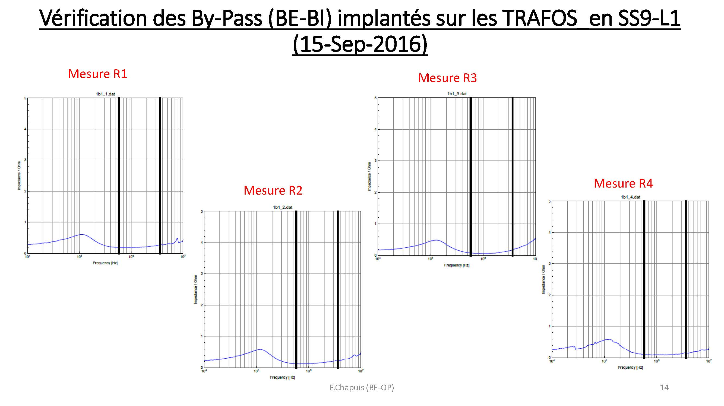

Slide 12
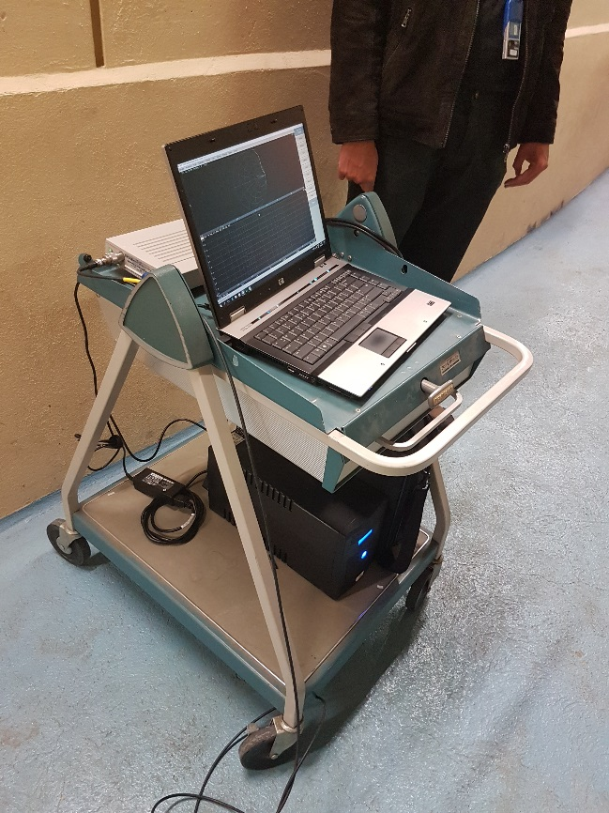
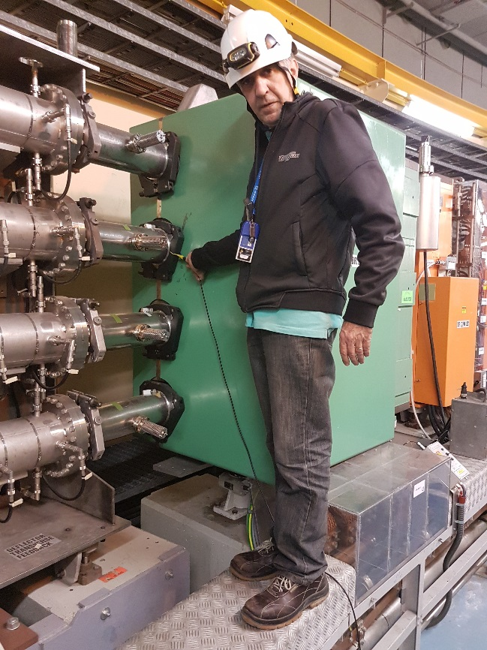
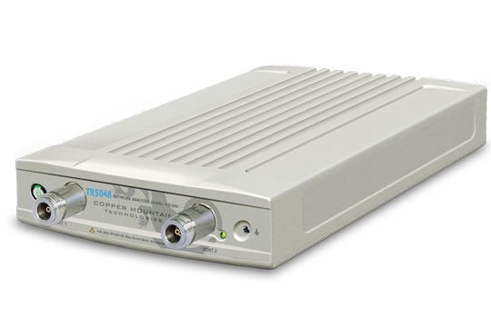
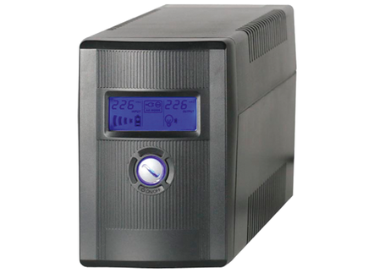
History
2017 On PSB:
Copper Mountain Technologies TR5048
Used with a laptop,
Needs 1.25A, 12V, power supply,
Very fast scanning,
We used this trolley with only the UPS powering,
All 120 measurements in about 1hour,
Radiation taken: Joao 8uS, Bruno 4uS.

Slide 13
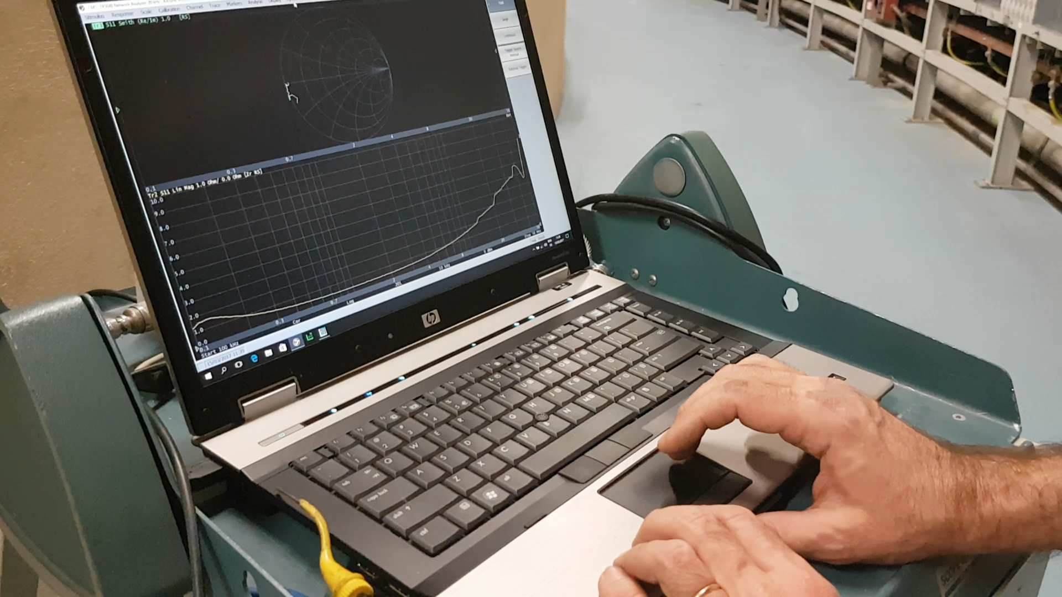
Video Showing file saving

Slide 14
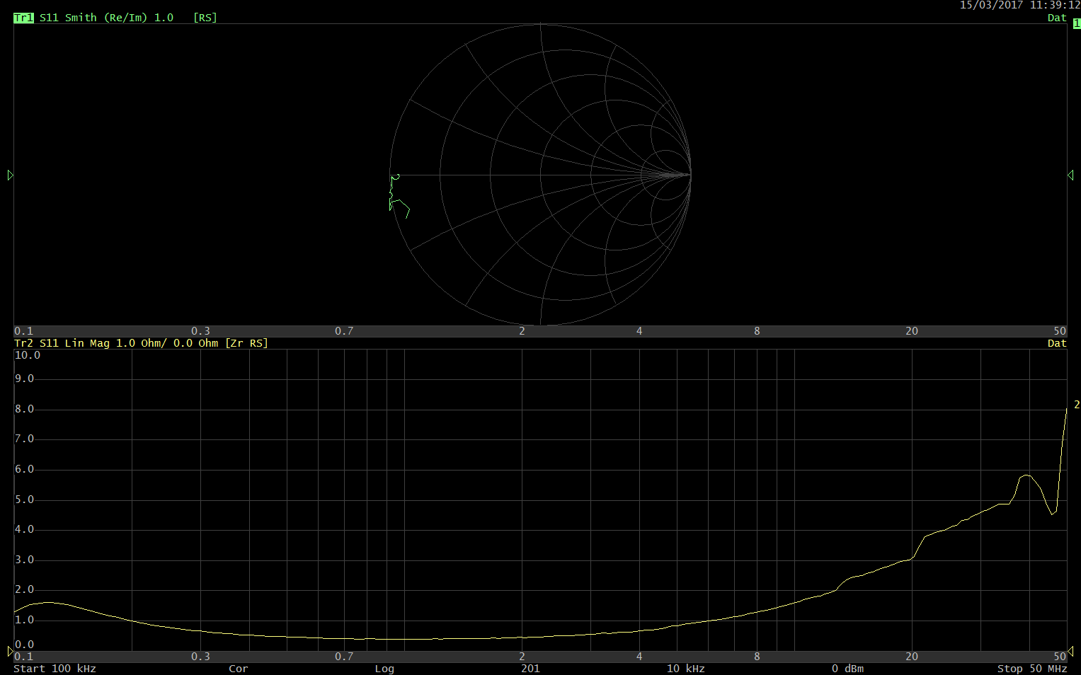
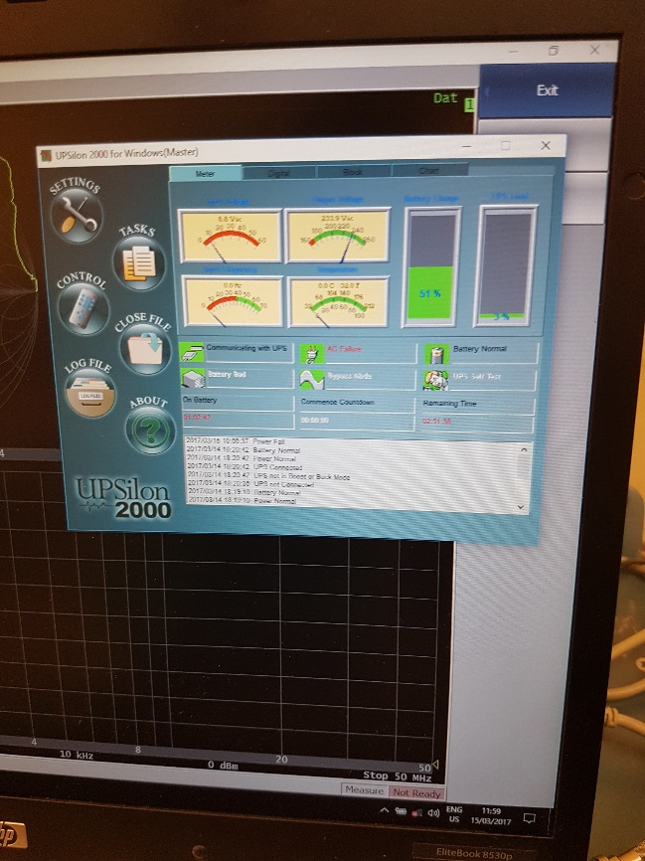
BHZ82 Ring 2
UPS Management software

Slide 15
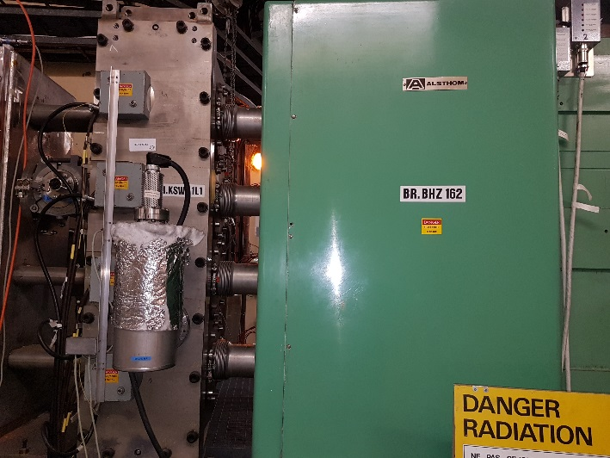
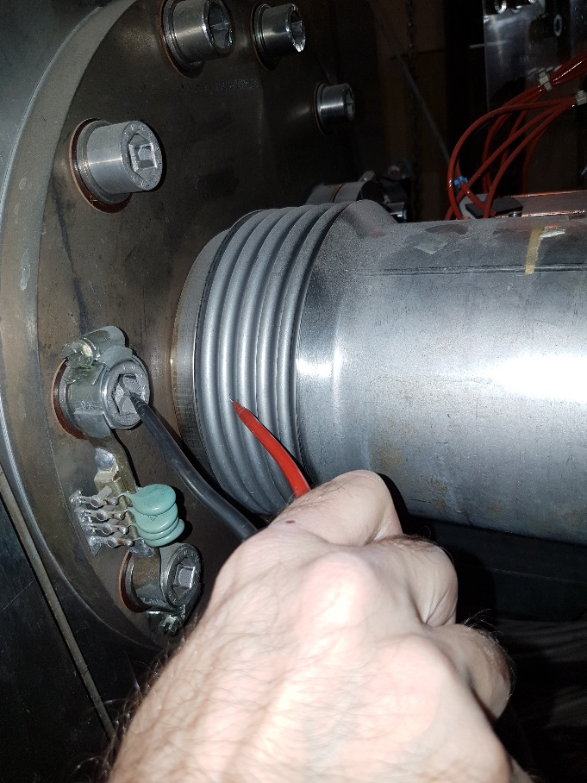
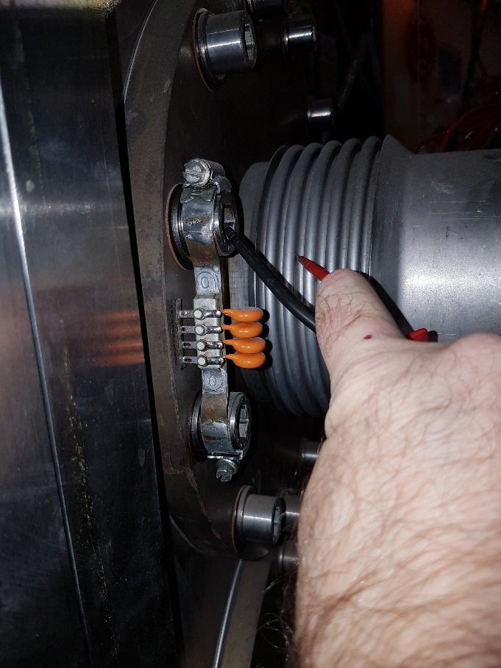
Special RF Bypasses at BI.KSW1L1
UPS Management software

Slide 16
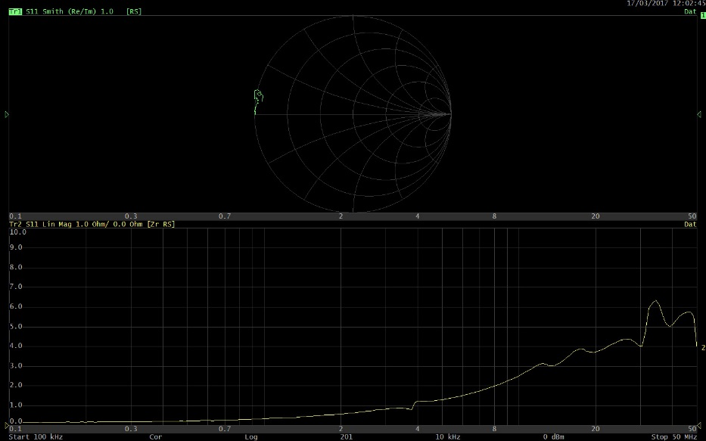
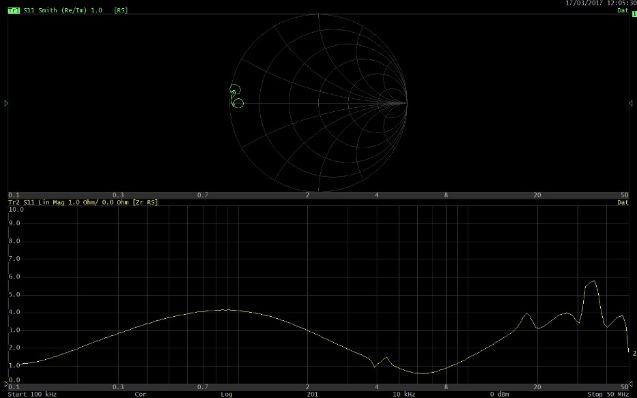

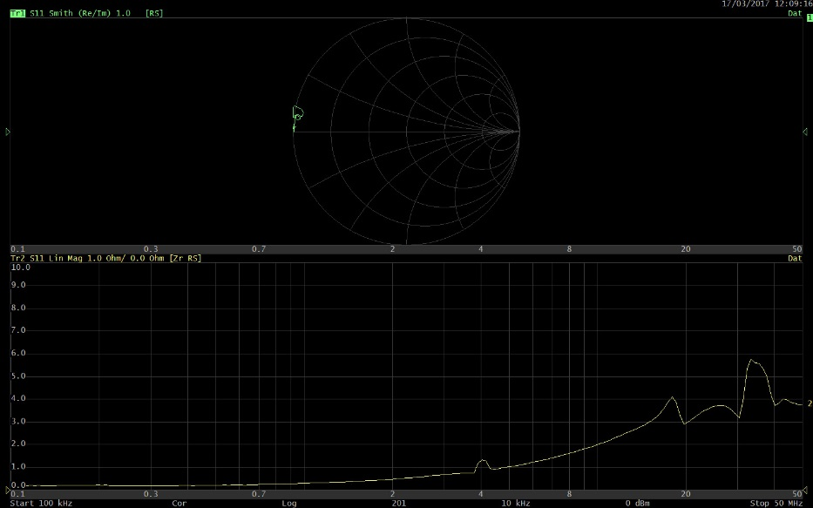
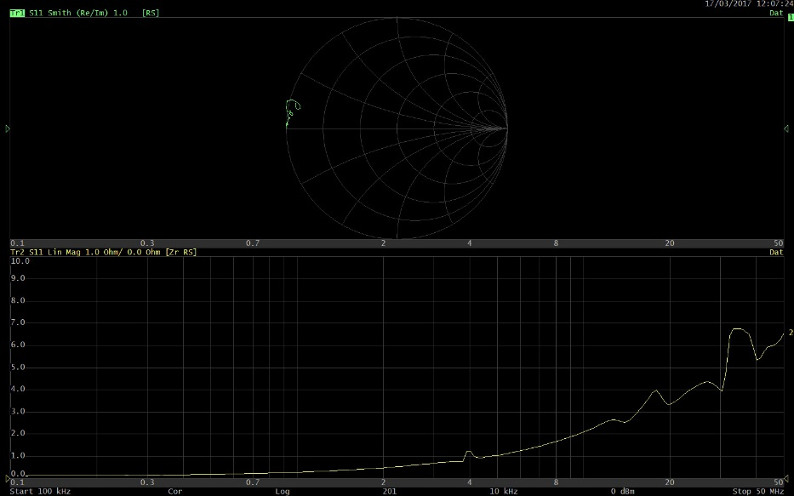
Ring 1
Ring 2
Ring 3
Ring 4

Slide 17
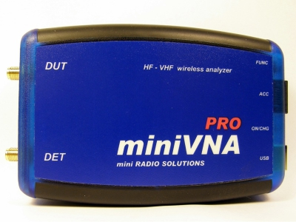
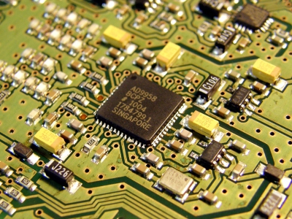
All data in EDMS
PS: https://edms.cern.ch/document/434204/1
PSB: https://edms.cern.ch/document/1767548/1
Conclusion:
All 120 measurements in about 1 hour without saving plots,
The UPS can handle it, over 50% left,
Radiation taken: Joao 8uS, Bruno 4uS,
Measurement from interior or exterior of the ring could improve speed of measurements,
The biggest part of time can be saved if cord extension is avoided,
Continue to search a better portable USB connected VNA solution, automatization of the measurements.

