Slide 1
Welcome to CERN
“Magic is not happening at CERN, magic is being explained at CERN.” Tom Hanks
João BENTO
BE Department Presentation available at http://cern.ch/jbe/CERN/visits

Slide 2
Your visit at CERN
Agenda
30 minutes presentation
10 minutes movie
Visit of 1 or 2 itineraries for 2 hours
Other practical informations
Do not hesitate to ask questions
You can take pictures and shoot film everywhere
Microcosm freely accessible from 9am till 5pm (downstairs)
CERN Shop from 11am till 5pm (hall)
Lavatories nearby the Microcosm entrance

Slide 3
Let’s start with a presentation
What?
Why?
How?
So what?

Slide 4
What?

Slide 5
What means « »?
1952
1954
CERN
C
E
R
N
Conseil Européen pour la Recherche Nucléaire
Organisation Européenne pour la Recherche Nucléaire
European
Council for
Nuclear
Research
European
Organization for
Nuclear
Research
European Laboratory
for Particle Physics

Slide 6
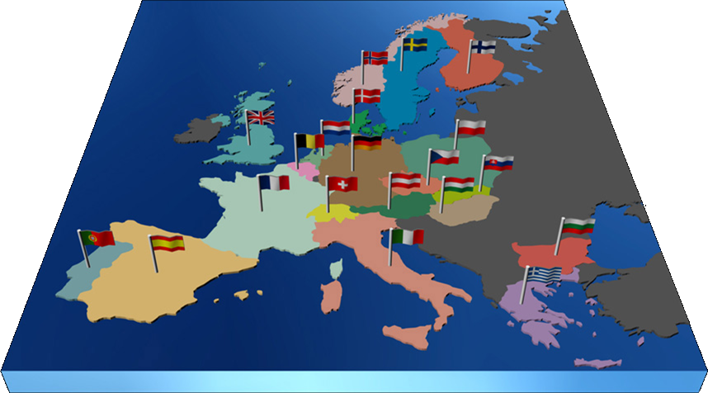
The largest particle physics lab in the world
Annual budget in 2007 982 MCHF (610 MEUR)
External funding for experiments
People
2415 Staff 730 Fellows and associates 200 Students 9133 Users 2000 External Firm
Twenty Member States
Austria, Belgium, Bulgaria, Czech Republic, Denmark, Finland, France, Germany, Greece, Italy, Hungary, Netherlands, Norway, Poland,Portugal, Slovakia, Spain, Sweden, Switzerland, United Kingdom
Eight Observer States European Commission, USA, Russian Federation, India, Israel, Japan, Turkey, UNESCO

Slide 7
Why?

Slide 8
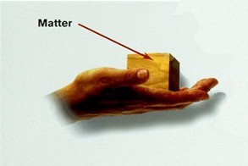
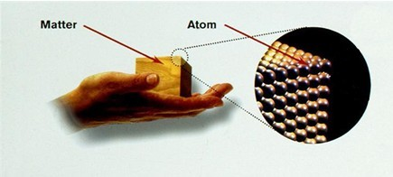
Do fundamental research
By answering questions like the structure of matter…
4th - 5th
century
BC
End of 19th century
Beginning of 20th century
1960s

Slide 9
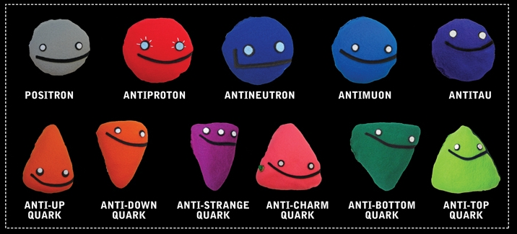
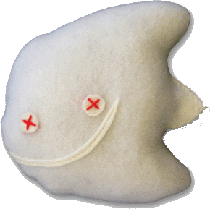
Checking existing theories: the standard model
LEPTONS
QUARKS
ORDINARY MATTER
ELECTRON
ELECTRON NEUTRINO
UP
DOWN
MUON
MUON NEUTRINO
CHARM
STRANGE
TAU
TAU NEUTRINO
TOP
BOTTOM
GLUONS
Strong Force
PHOTONS
Electro-Magnetic Force
BOSONS
Weak Force
GRAVITONS
Gravity
4 forces
Images: www.particlezoo.net

Slide 10
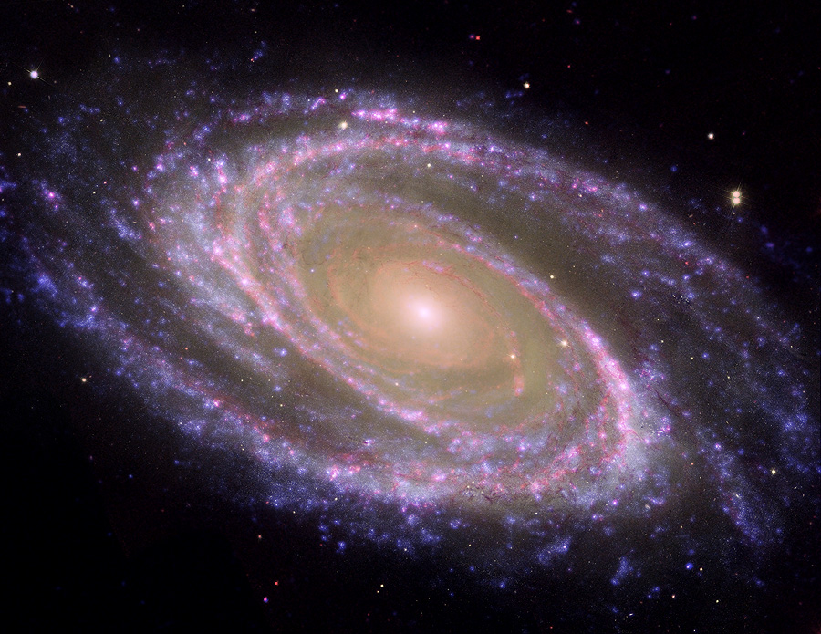
Answering fundamental questions…
How explain particules have a mass?
Newton could not explain, neither can we…
What is 96% of the Universe made of ?
We can only see 4% of its estimated mass!
Why isn’t there antimatter in the Universe?
Nature should be symetric…
What was the state of matter just after the « Big Bang » ?
Travelling back to the earliest nstants of the Universe would help…
Higgs Boson

Slide 11
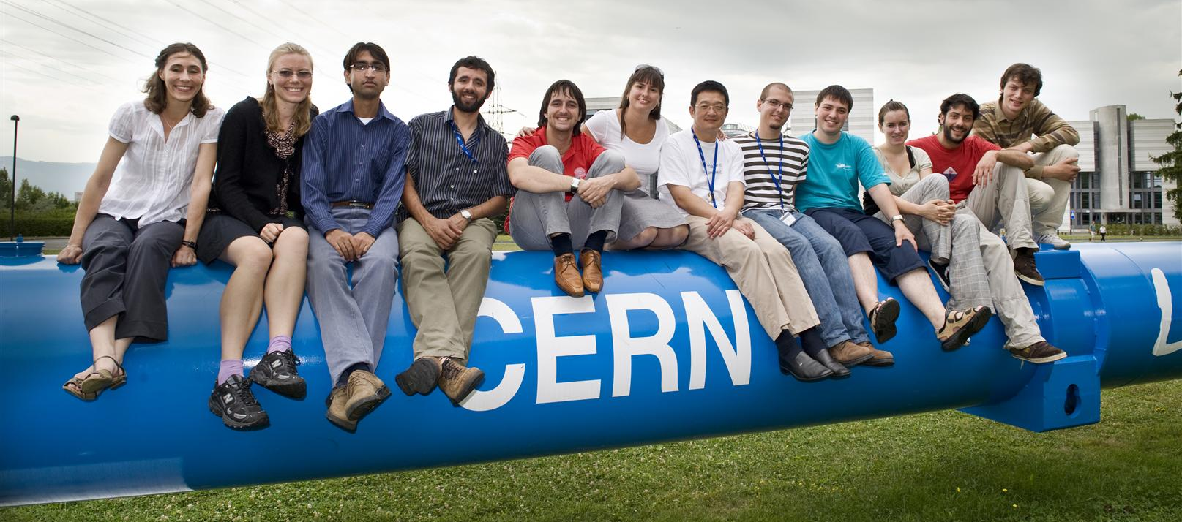
Bringing nations together and educate
Biggest international scientific collaboration
Various students programmes
Over 100 countries
Hundreds of physics institutes
Half of the world’s particle physicists

Slide 12
How?

Slide 13
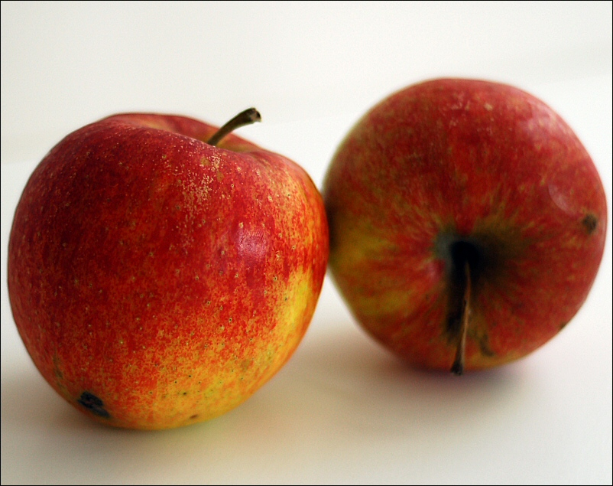
By accelerating and colliding objects…

Slide 14
At incredible levels of energy!
E=mc²

Slide 15
CERN’s accelerators chain

Slide 16
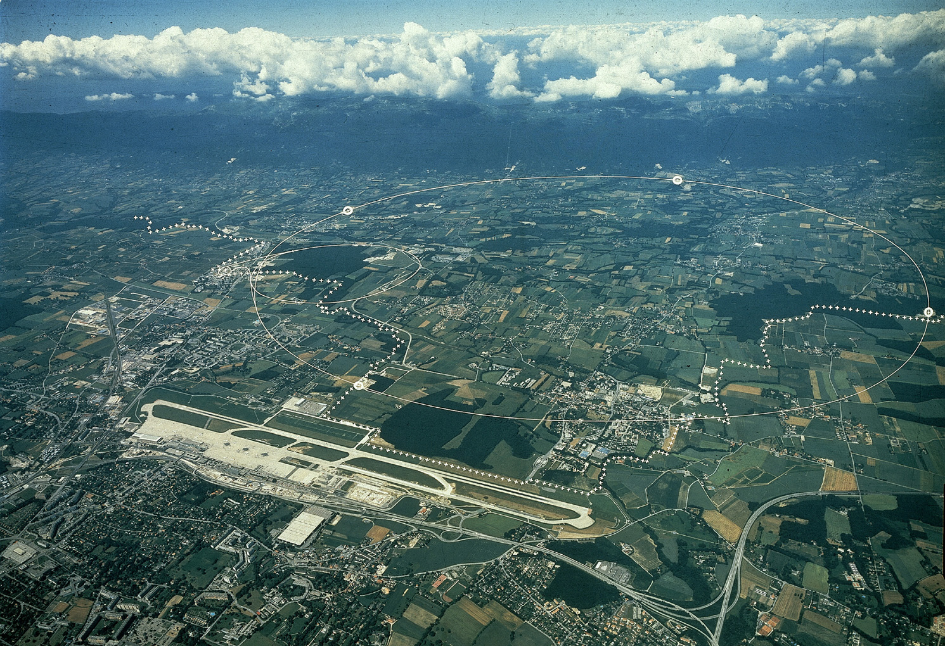
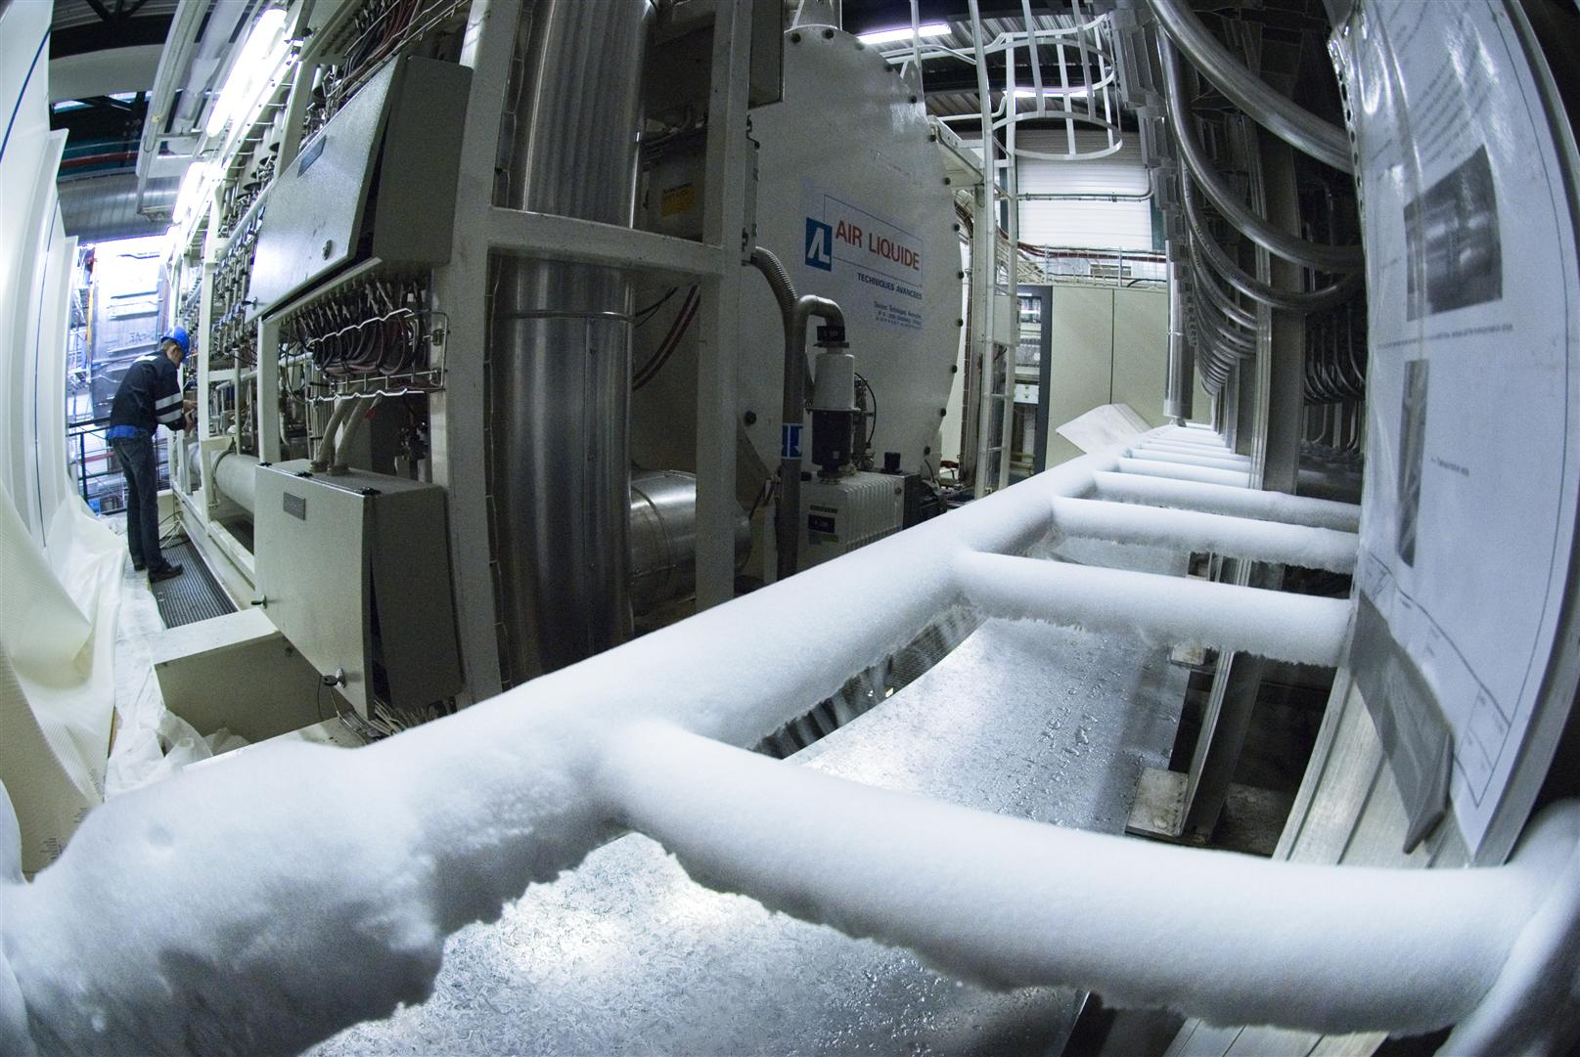
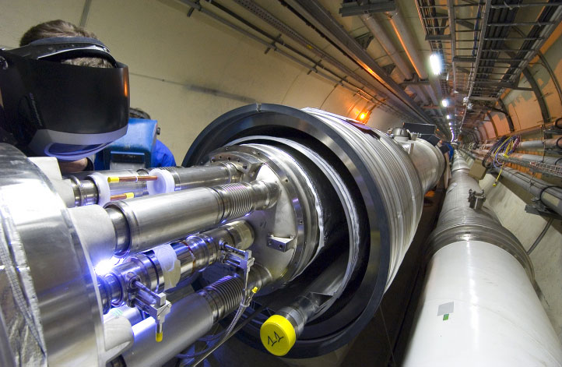
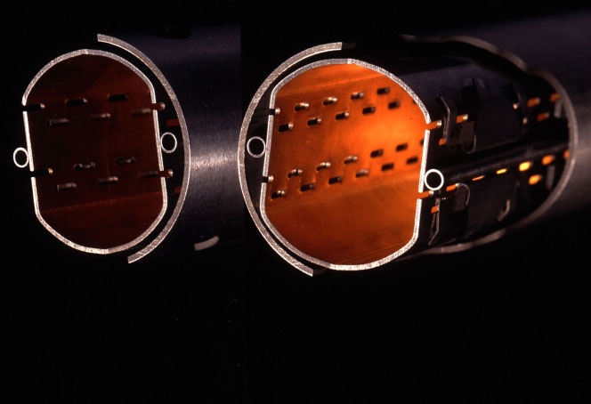
The largest particle accelerators
17 miles (27km) long tunnel
Thousands of superconducting magnets
Ultra vacuum:
10x emptier than on the Moon
Coldest place in the Universe: -271° C
In safe conditions!

Slide 17
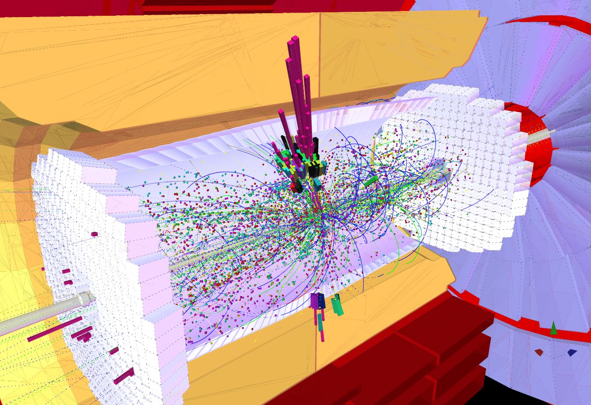
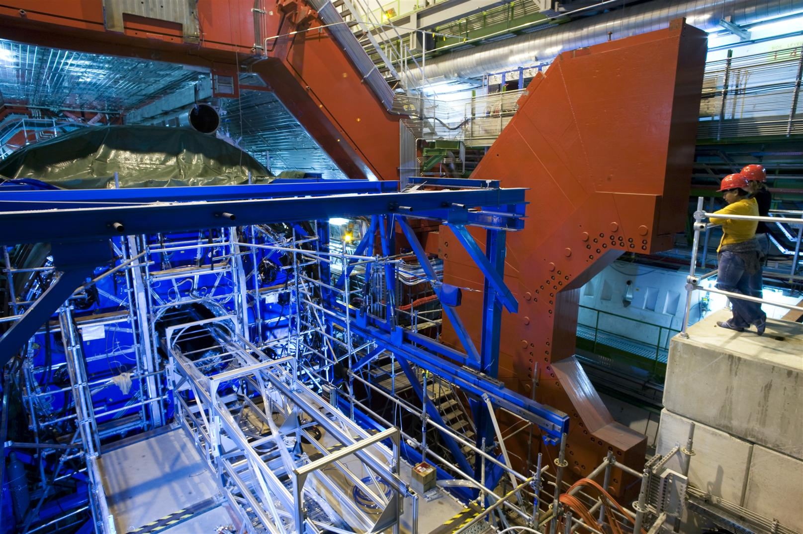
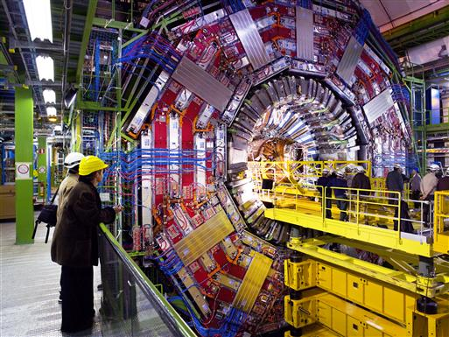
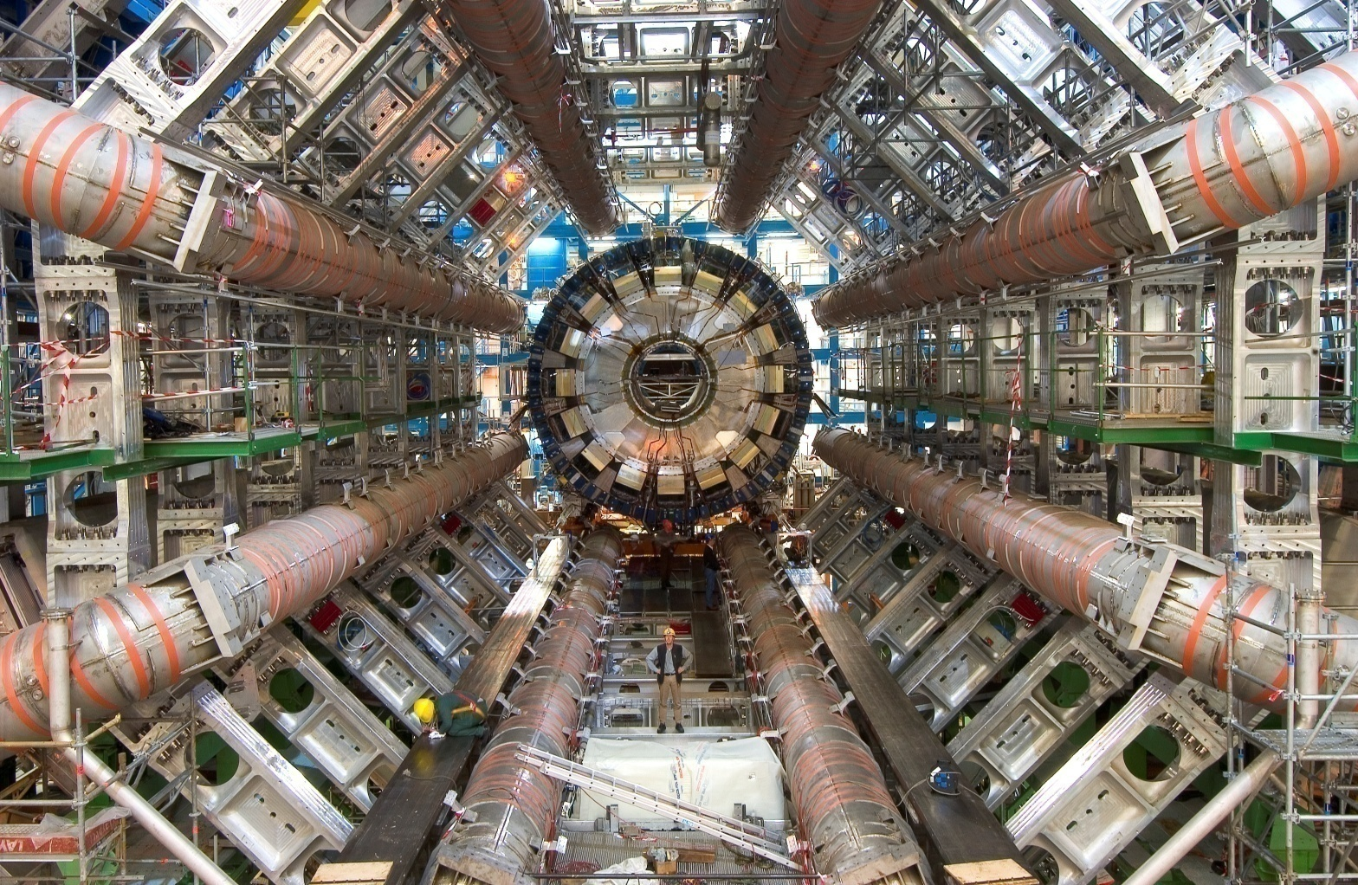
The biggest and most sophisticated detectors
Cathedrals of science 100m underground
600 million collisions per second detected
by hundreds of
million sensors
Thousands of collaborators
for each detector
In safe conditions!

Slide 18
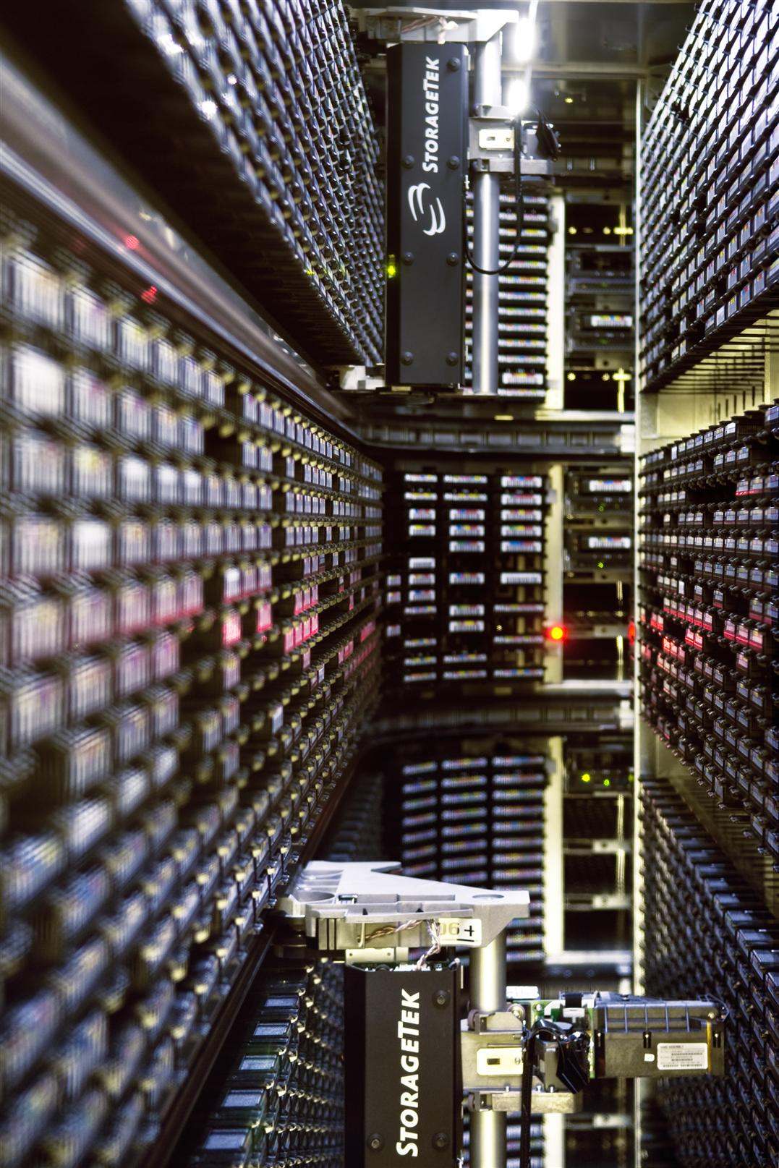
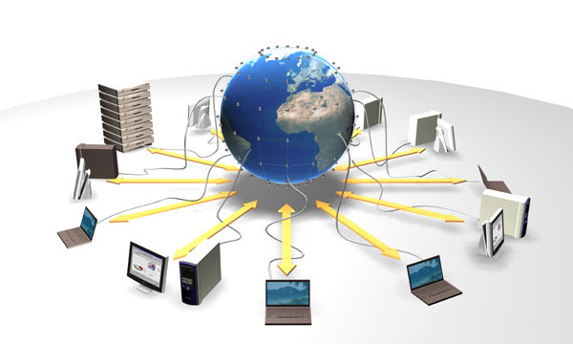
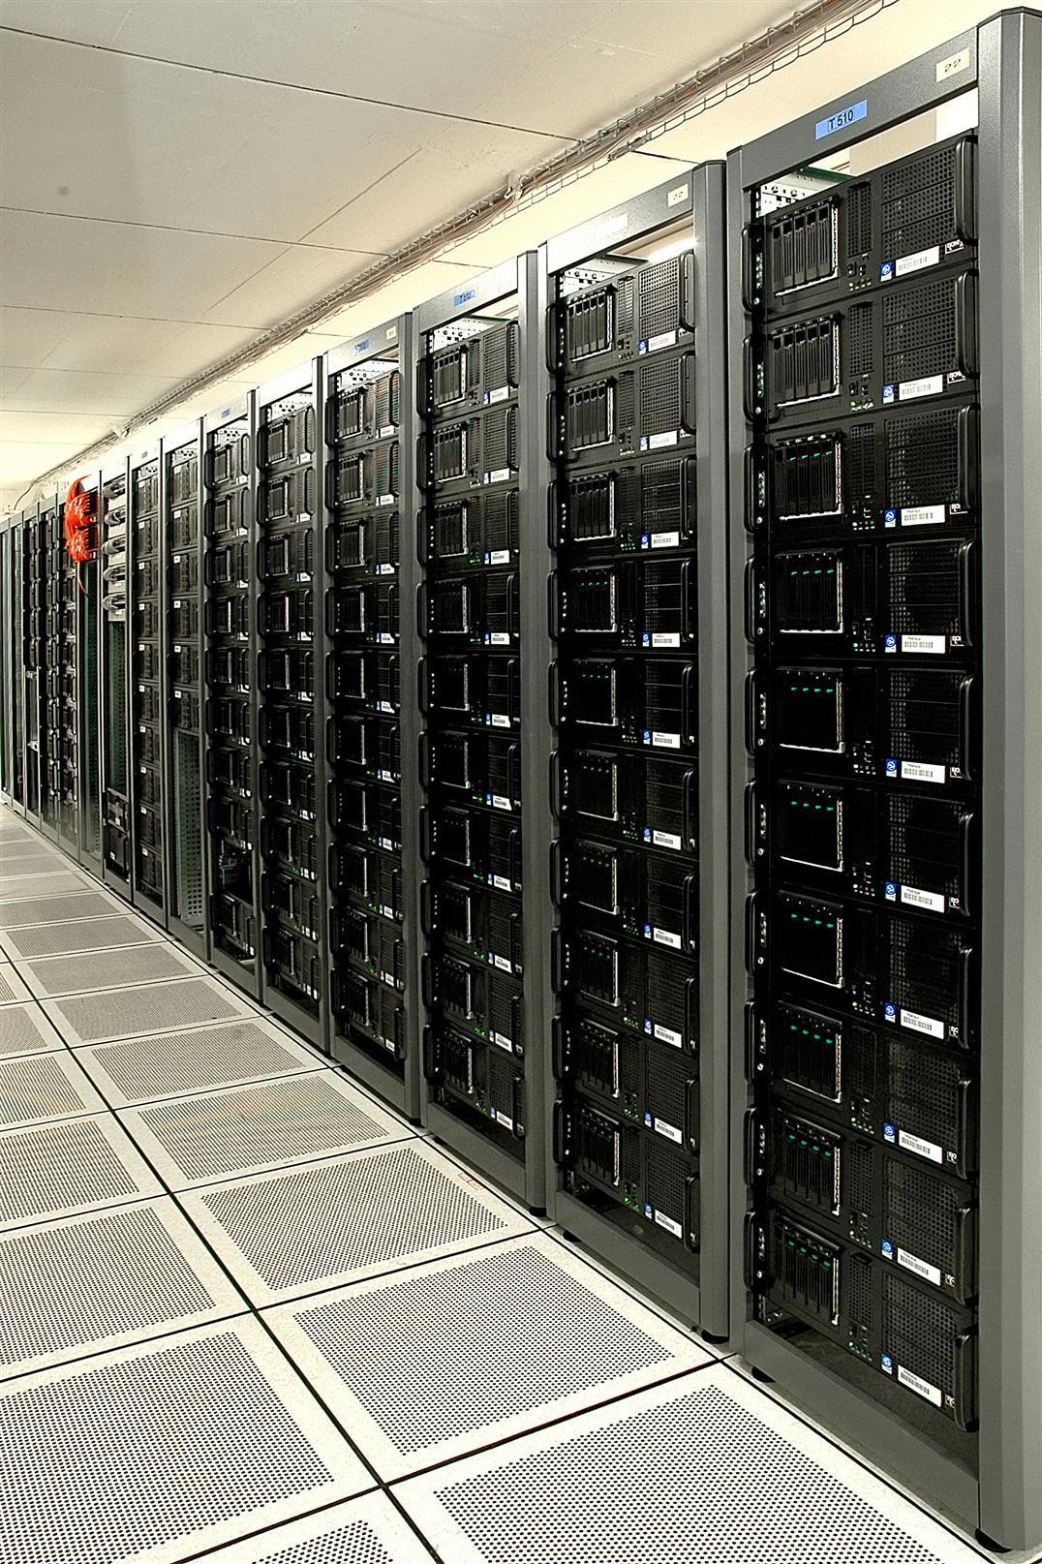
The most extensive scientific computing grid
15 Petabytes (15 millions of GB) of data every year
100’000 processors
200 computer centres around the planet

Slide 19
So what?

Slide 20
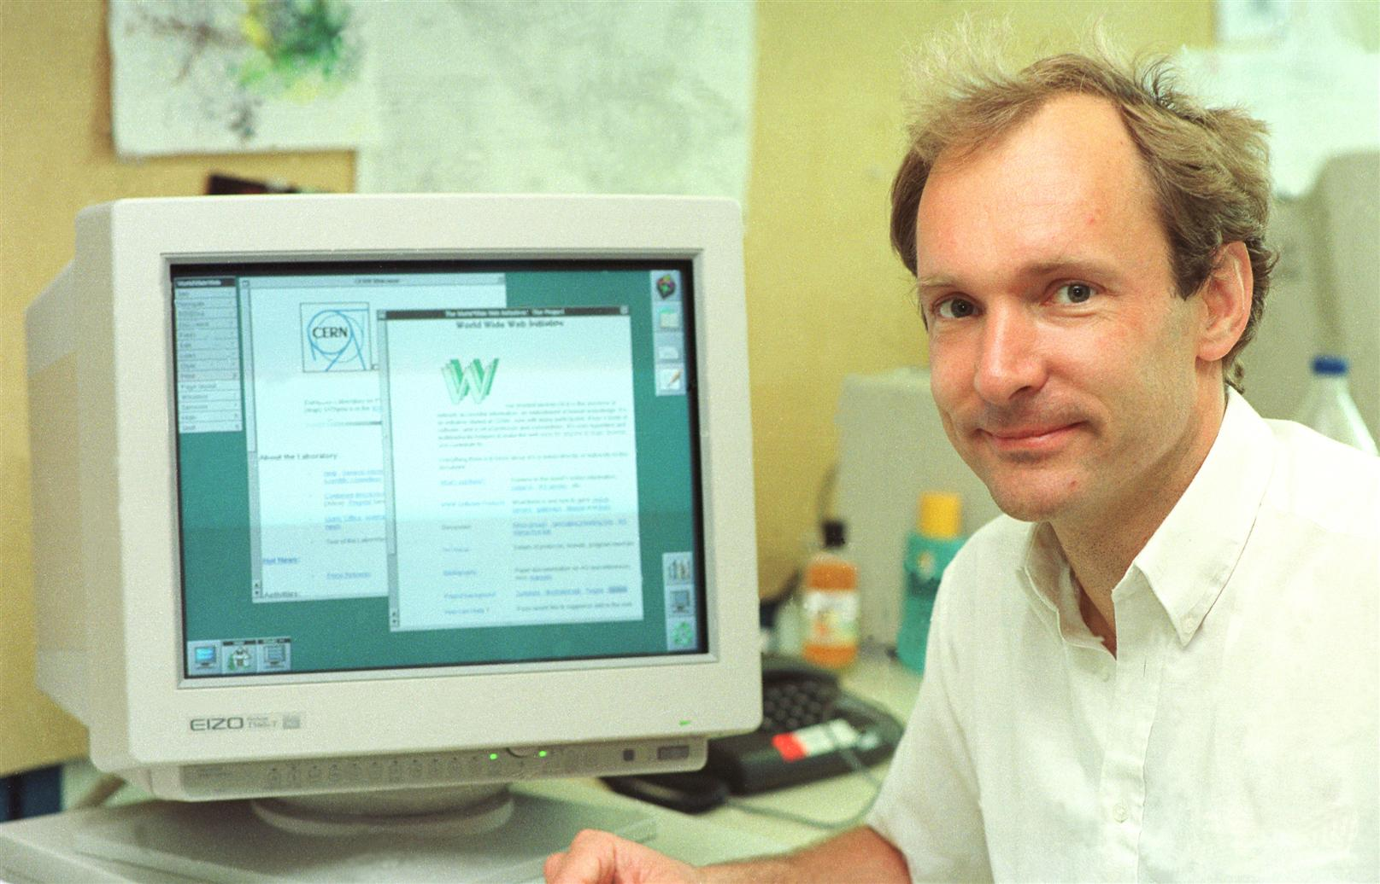
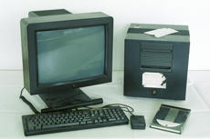
Practical applications: the World Wide Web
Was developed in the frame of the LHC project in 1989!
Freely given to the World!

Slide 21
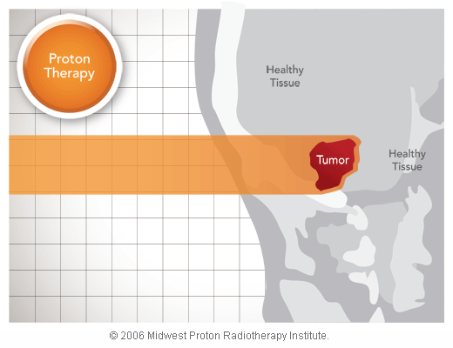
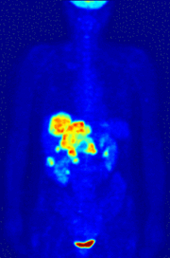
Practical applications: cancer treatment
For both detection and cure of cancers
PET Scans
Hadron Therapy

Slide 22
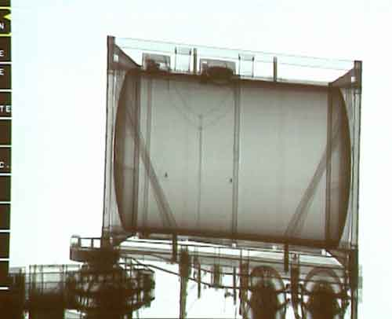
Practical applications: detectors
Scanning trucks in less than one hour without unloading them!

Slide 23
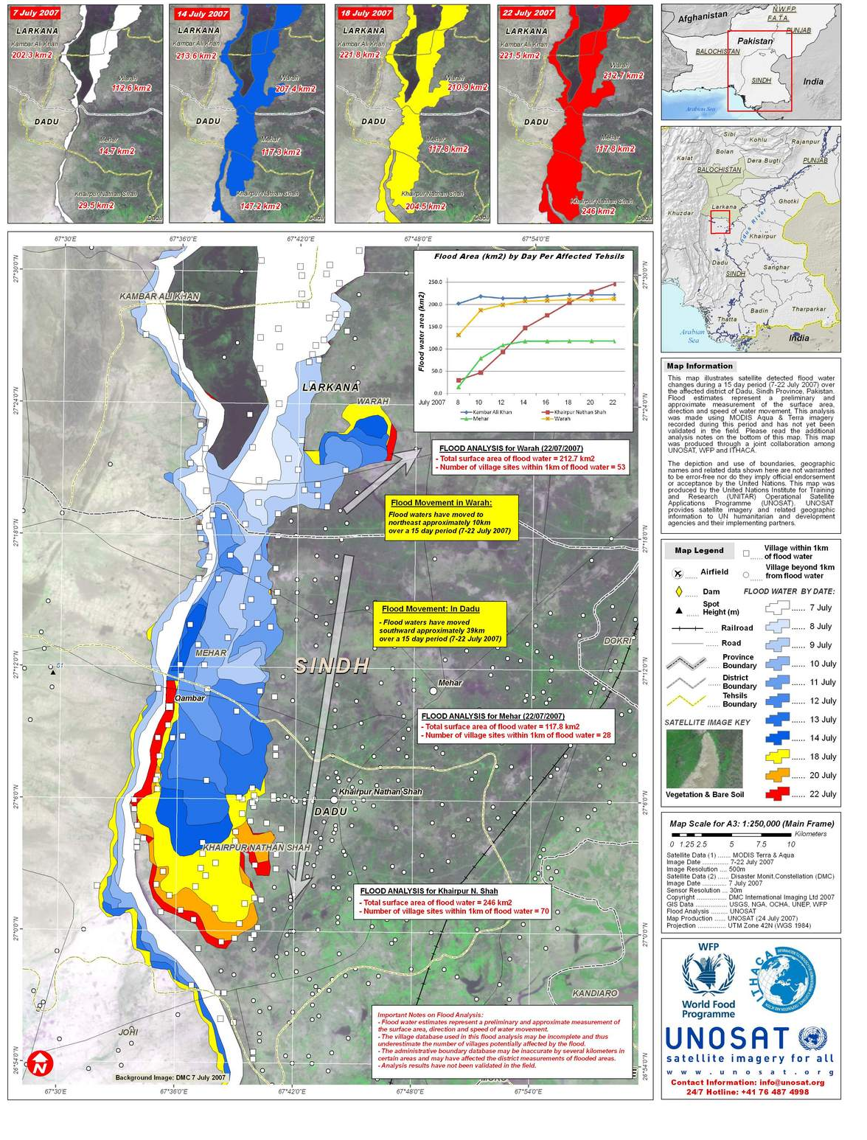
Practical applications: using the Grid
Ultra high-speed processing
of satellite imagery in the
case of natural disasters

Slide 24
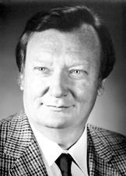
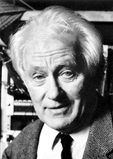
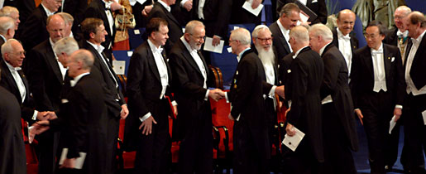
And of course… some Nobel prizes!
Carlo Rubbia (with Simon van der Meer)
“for their decisive contributions to the large project, which led to the discovery of the field particles W and Z, communicators of weak interaction”
George Charpak
“for his invention and development of particle detectors, in particular the multiwire proportional chamber”

Slide 25
What’s new?

Slide 26
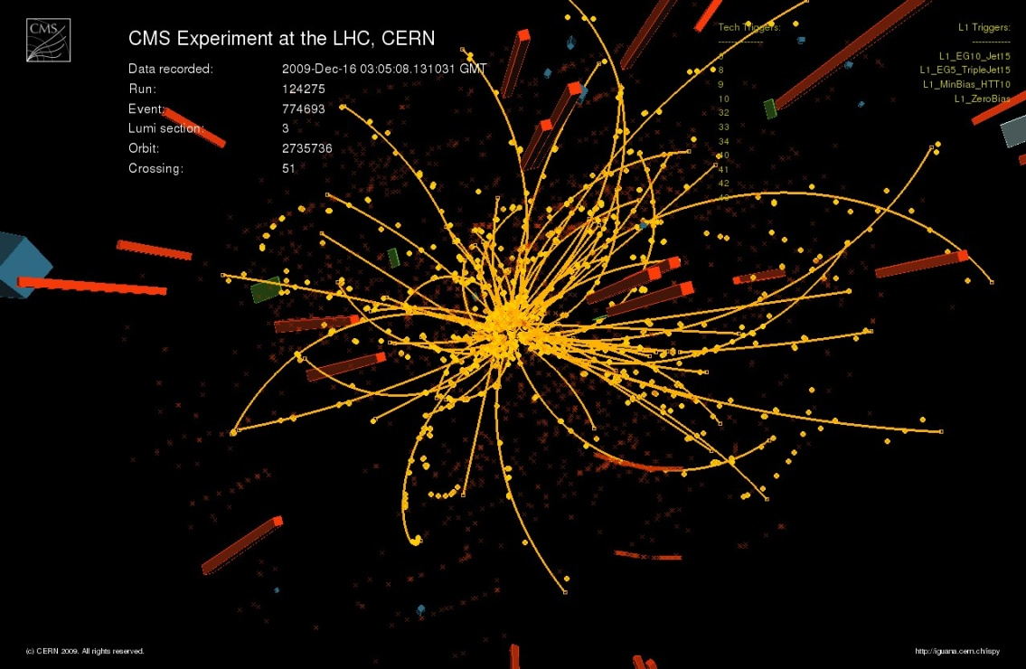
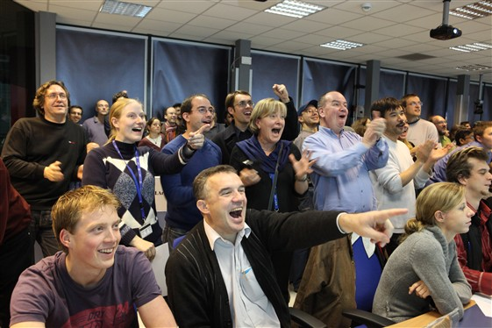
LHC is back since November 2009!
18 to 24 months at 3.5 TeV as from mid-Feb 2010
Then long maintenance phase
7.5 Tev exploitation in 2012?

Slide 27
Conclusion
Fundamental research laboratory
World’s biggest international scientific collaboration
Pushing technology to its limits
Multiple practical applications
Visit our websites: Informations: www.cern.ch
CERN TV: www.youtube.com/cern Recruitment: www.cern.ch/jobs
Thank you!

